Slide 1
Review of Arrays, Structures and Union

Slide 2
Review of Arrays
An array is a collection of one or more values of the same type. Each value is called an element of the array. The elements of the array share the same variable name but each element has its own unique index number (also known as a subscript).
An array is stored so that the position of each element can be computed from its index tuple by a mathematical formula.

Slide 3
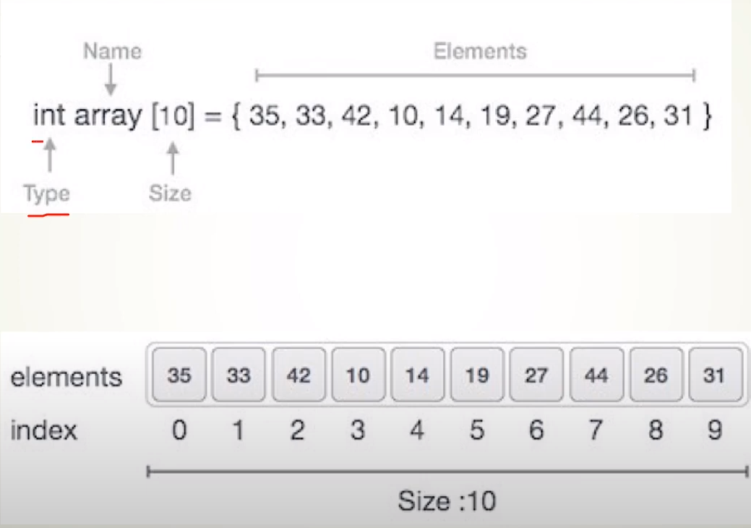
Review of Arrays

Slide 4
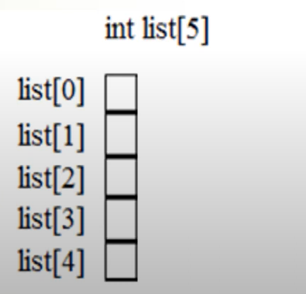
Arrays in C
A one-dimensional array can be declared as follows:
int list[5]; /array of 5 integers

Slide 5
STRUCTURES
Structure is a user-defined datatype in C language which allows us to combine data of different types together.
Structure helps to construct a complex data type which is more meaningful. It is somewhat similar to an Array, but an array holds data of similar type only.

Slide 6
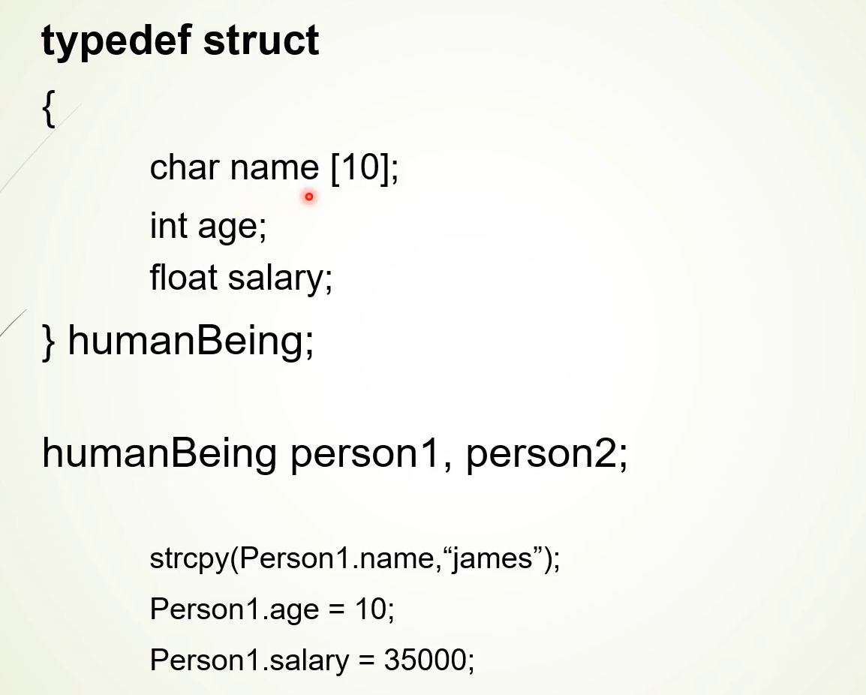

Slide 7
UNIONS
Union is a user defined data type but unlike structures, union members share same memory location.

Slide 8
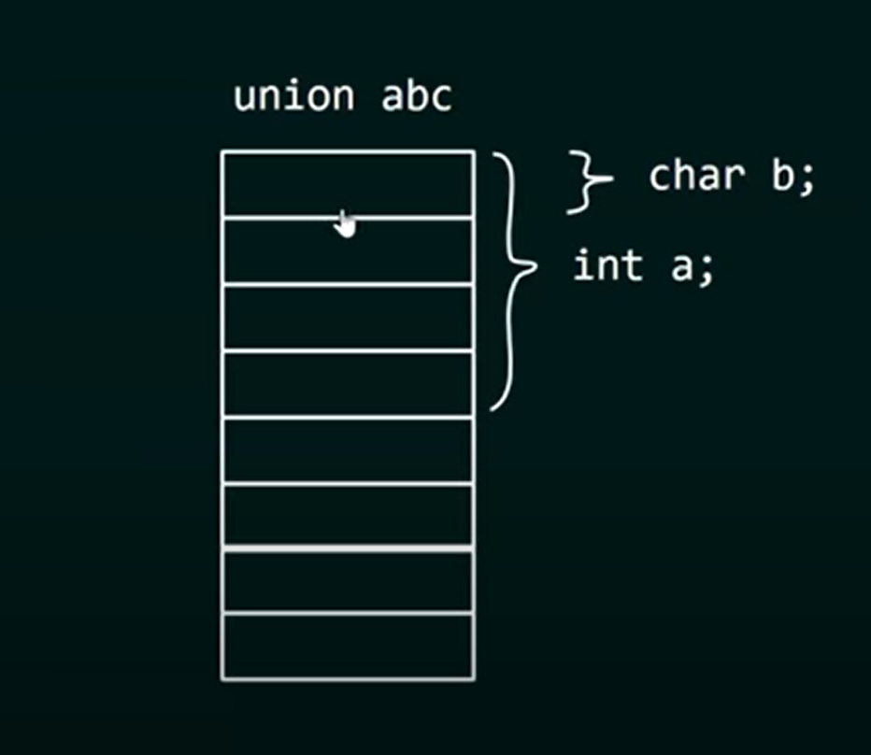

Slide 9
